Slide 1
FATF/GIABA Mutual Evaluation Process and the Role of the NGOs in the Successful Conduct of the Mutual Evaluation Review (MER)
Abdul Rahman Mustapha
Head, Monitoring and Analysis
Nigerian Financial Intelligence Unit

Slide 2
What is Mutual Evaluation

Slide 3
Current Mutual Evaluation Exercise Concept
Technical Compliance
Assessment addresses the specific requirements of the FATF Recommendations, principally as they relate to the relevant legal and institutional framework of the country, and the powers and procedures of the competent authorities. These represent the fundamental building blocks of an AML/CFT system.

Slide 4
Current Mutual Evaluation Exercise Concept
Technical Compliance and Effectiveness assessments together shows the extent to which the country is compliant with the FATF Standards and how strong the country is in maintaining a effective & strong AML/CFT system.

Slide 5
Component of MER Assessment
Technical Compliance
Effectiveness ratings
Compliant (C) | There are no short comings
Largely Compliant(LC) | There are only minor short comings
Partially Compliant (PC) | There are moderate short comings
Non Compliant (NC) | There are major short comings
Not Applicable (NA) | A requirement does not apply, due to structural,l legal or institutional features of a country.
High level of effectiveness | The immediate outcome is achieved to a very large extent. Minor improvement is needed
Substantial Level of effectiveness | The immediate outcome is achieved to a large extent. Moderate improvements needed.
Moderate level of effectiveness | The immediate outcome is achieved to some extent. Major improvements needed.
Low level of effectiveness | The immediate outcome is not achieved or achieved to a negligible extent. Fundamental improvement needed.

Slide 6
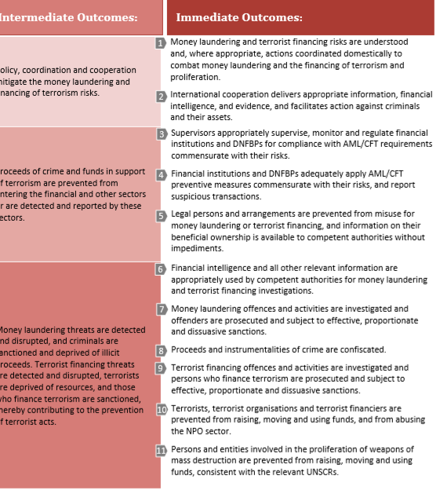
The FATF Eleven Immediate Outcomes

Slide 7
Current Mutual Evaluation Exercise Concept
Effectiveness
It seeks to assess the adequacy of the implementation of the FATF Recommendations, and identifies the extent to which a country achieves a defined set of outcomes that are central to a robust AML/CFT system.
The focus of the effectiveness assessment is therefore on the extent to which the legal and institutional framework is producing the expected results.

Slide 8
Methodology
High level Outcomes
Policy, Coordination and Cooperation to mitigate the ML and FT risks
Proceeds of Crime and Funds in support of Terrorism are prevented from entering the financial and other sectors (DNFBP) are detected and reported by these sectors.
ML threats detected, disrupted and criminals found sanctioned and deprived of proceeds. TF threats detected and disrupted, Terrorist deprived of resources and financiers of terrorism are sanctioned thereby contributing to the prevention of terrorist acts

Slide 9
Methodology
Immediate Outcomes
High level outcome 1- Policy, Coordination and Cooperation to mitigate the ML and FT risks
Understanding ML/TF Risks, appropriate actions and domestic cooperation to combat ML/FT/Proliferation.
International Cooperation to delivers appropriate information financial intelligence, and evidence, and facilitates action against criminals and their assets

Slide 10
Mutual Evaluations requirements –role of the DNFBP sector
High Level Outcome 2
Proceeds of Crime and Funds in support of Terrorism are prevented from entering the financial and other sectors (DNFBP) are detected and reported by these sectors.
Immediate Outcome 4. -Financial Institution and DNFBPs adequately apply AML/CFT preventive measures commensurate with their risks and report Suspicious Transactions

Slide 11
I.O - 4
DNFBPs
Preventive Measures applicable to DNFBPs
Risk assessment- Products/Service/Customers
National Risk Assessment Results
CDD Measures
KYC, EDD, SDD
Monitoring
Reporting functions
Report to the NFIU?
Mechanism for reporting
Timely reporting, etc

Slide 12
I.O 10
High Level Outcome- 3
IO-10: Terrorist, Terrorist organizations and Terrorist financiers are prevented from raising, moving and using funds, and from abusing the NPO sector.
This means;
DNFBPS should take the following reasonable steps to;
Understand and safeguard their organization from being used to raise funds by terrorist.
Understand and safeguard their organization from being used to move funds.
Understand and safeguard their organization from being used in utilizing their terrorist funds?

Slide 13
Concept of Risk
Risk = Vulnerability x Threat x Impact
Vulnerability=An error or a weakness in the design, implementation, or operation of a system.
Threat=An adversary that is motivated to exploit a system vulnerability and is capable of doing so system vulnerability and is capable of doing so
Impact= the likelihood that a vulnerability will be exploited or that a threat may become harmful .

Slide 14
Conclusion
Know your Industry
What do you (do) sell? What products (service) do you provide?
Who is your customer or client?
How much do you know him?
Where do you operate?
What is your risk exposure?
What are your mitigants?

Slide 15
THANK YOU
QUESTIONS ?

Slide 16
QUESTIONS

